Slide 1

Visual Question-Answering
Team Members:
Abdalla Shaaban Elsayed
Rabah Jamal Mohammed Ali
Abdullah Abdelkader Roshdy
Abdullah Mahmoud Abdullah
Supervisor:
Dr\ Sally Saad
TA\ Ahmed Salah
1

Slide 2
Outline
Introduction
Architecture
Tools
Method :
Question Hierarchy
Attention
Time Plan
References
2

Slide 3
Outline
Introduction
2

Slide 4
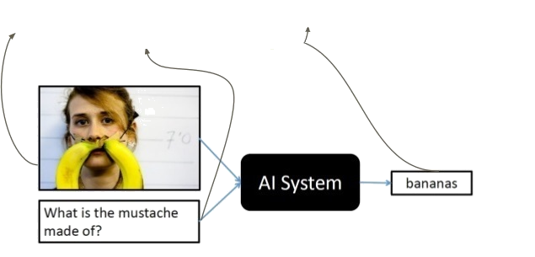
Introduction​
Question-Answering
Visual
Predict the Answer of a given question related to an image.
5

Slide 5
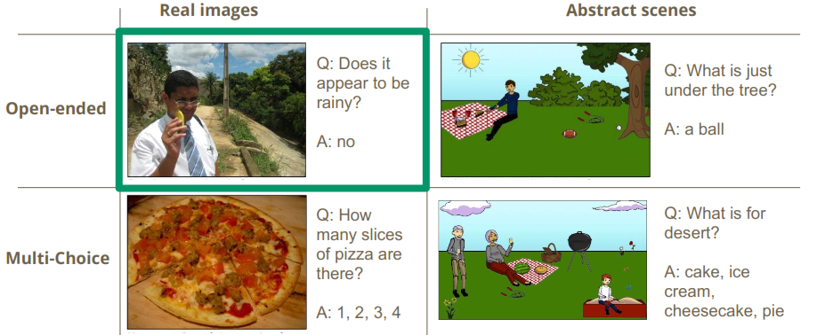
Types of Visual Question-Answering
6

Slide 6
Outline
Introduction
Architecture
2

Slide 7
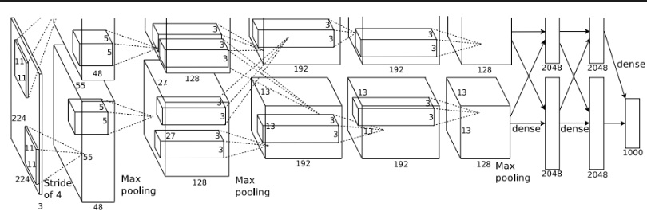
CNN Architecture
Alex Net
VGG Net
Google Net
Res Net
6

Slide 8
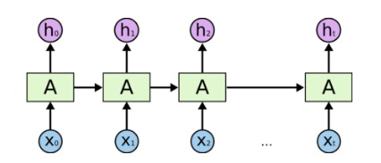
Recurrent neural network
Neural network that is used for processing sequential data .
Used in :
Language Modeling
Translation
Speech recognition
6

Slide 9
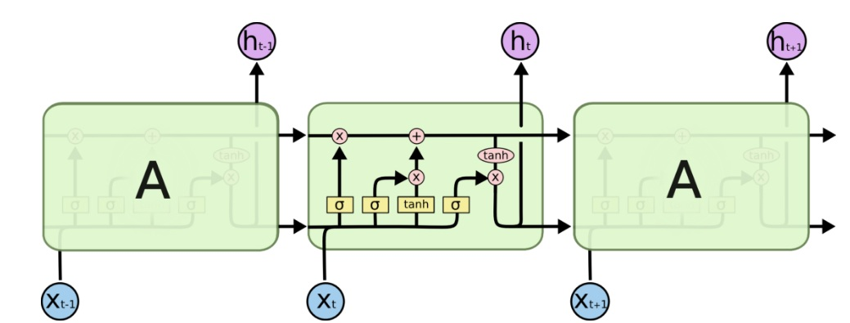
Recurrent neural network
Long short term memory (LSTM)
GRU
6

Slide 10
Outline
Introduction
Architecture
Tools
2

Slide 11
Tools
Languages :
Python for preprocessing the datasets.
Java script for the UI (optional).
Libraries and Frameworks :
NLTK, Pillow (Python Imaging Library) for preprocessing the dataset.
Tensor Flow to build the model.
26

Slide 12
Outline
Introduction
Architecture
Tools
Method :
Question Hierarchy : word level
2

Slide 13
Word level
Word embedding : A technique to embed the words to vector space , so that the words which have similar or close meaning have close vectors .
Normalize the question to be all ( upper case or lower ) .
Apply one hot-encoding for a given question .
[1, 0, 0, 0, 0] = how
[0, 1, 0, 0, 0] = many
[0, 0, 1, 0, 0] = horses
[0, 0, 0, 1, 0] = are
[0, 0, 0, 0, 1] = there
6

Slide 14
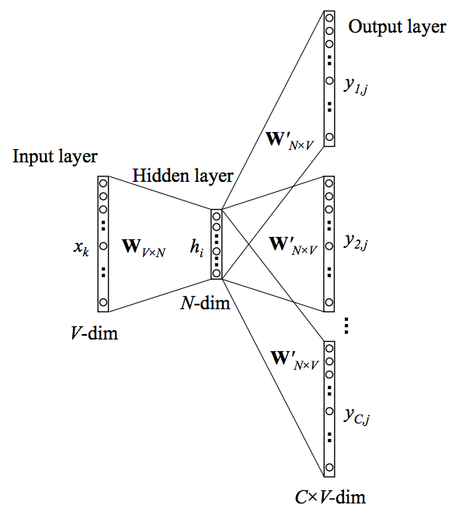
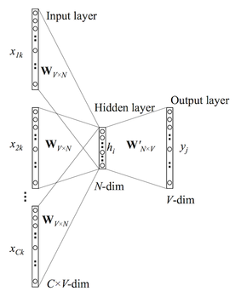
Word level
Word embedding Models : Skip-gram & Continuous Bag of Words (CBOW)
6

Slide 15
Outline
Introduction
Architecture
Tools
Method :
Question Hierarchy : phrase level
2

Slide 16
Phrase level
To compute the phrase features , we apply 1-D convolution on the word embedding vectors
The convolution and max-pooling processes exploit and summarize the local relation signals between consecutive words.
max-pooling layer :
is utilized to extract most informative features from among convolutions
maximizing the similarity between the context and the current word while minimizing the similarity between the context and all other negatively sampled words
6

Slide 17
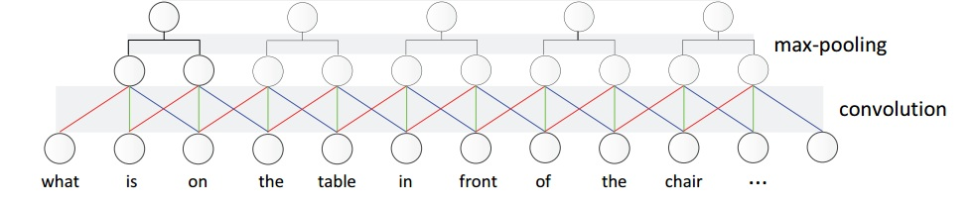
Phrase level
The meaningful composition “ of the chair ” is more likely to be pooled out, compared with the composition “ front of the ”.
6

Slide 18
Outline
Introduction
Architecture
Tools
Method :
Question Hierarchy : question level
2

Slide 19
Question level
We use a LSTM to encode the sequence of phrase level after max-pooling. The corresponding question-level feature is the LSTM hidden vector at time t.
6

Slide 20
Outline
Introduction
Architecture
Tools
Method :
Question Hierarchy
Attention
2

Slide 21
Attention
Visual attention : which spatial location at image should we look at given a text
Question attention : which part of the question should we look at given an image
Co-attention : applying both of them
6

Slide 22
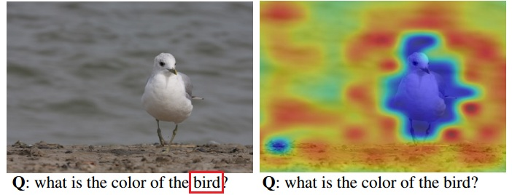
Question Attention vs Visual attention
6

Slide 23
Co-attention
Parallel Co-Attention : Parallel co-attention attends to the image and question simultaneously.
Alternating Co-Attention : In this attention mechanism, we sequentially alternate between generating image and question attention.
6

Slide 24
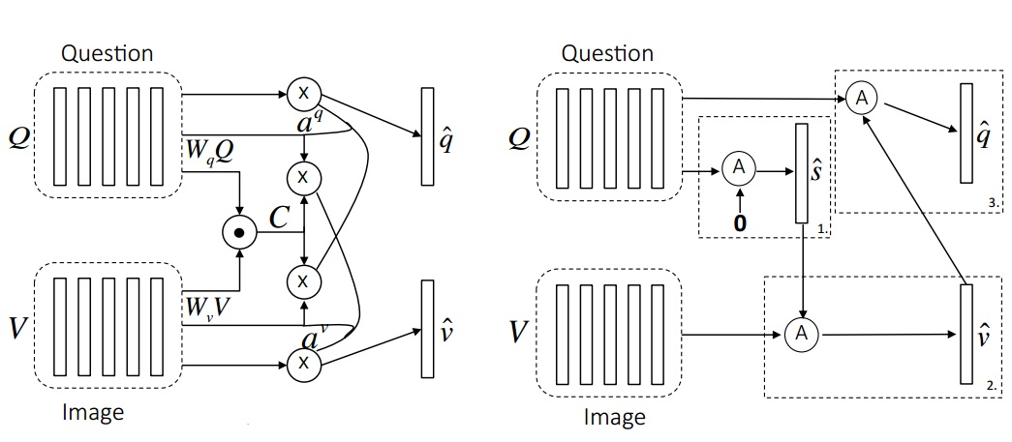
Co-attention
6

Slide 25
Outline
Introduction
Architecture
Tools
Method :
Question Hierarchy
Attention
Time Plan
2

Slide 26
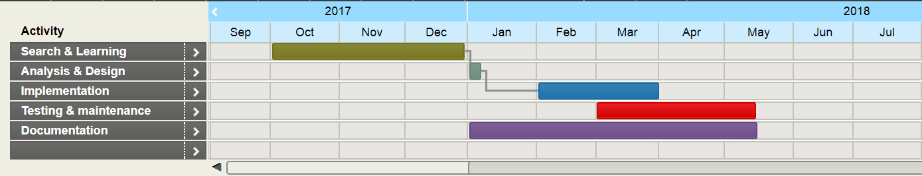
Time Plan
24

Slide 27
Outline
Introduction
Architecture
Tools
Method :
Question Hierarchy
Attention
Time Plan
References
2

Slide 28
References
Chenyue Meng and Yixin Wang, “Image-Question-Linguistic Co-Attention for Visual Question Answering”, 2016.
Alisha Rege and Payal Bajaj C, “From Vision to NLP: A Merge”, 2017.
Ronghang Hu and Jacob Andreas and Marcus Rohrbach, “Learning to Reason: End-to-End Module Networks for Visual Question Answering” , 2017.
Jiasen Luand Jianwei Yang and Dhruv Batra , “Hierarchical Question-Image Co-Attention for Visual Question Answering” , 2017
28

Slide 29
Questions
29

Slide 30
Thank You!
30

